Slide 1
Message from the International President to the Orientation Presenter(s)
Your international Membership Committee is so pleased to have you use this orientation presentation with your potential members. It makes no attempt to cover “everything” about the Society; our focus is on what is attractive to a potential member about the Society. Other areas (like our history, Founders, etc.) are incorporated into the new reorientation materials for the entire chapter, including new members.
The first slide of the presentation is slide 3. This slide and slide 2 are for you, the presenter, so please become familiar with the notes that accompany each slide, and understand the method of presentation as it is explained to you on the next slide.
Please insert your chapter name and location and state organization name on the first slide, but make no changes on any subsequent slides. It is our belief that this presentation will be most appealing to potential members. Please give us feedback on the outcome of your orientation using the new process.
Jensi Souders, International President, 2010-2012

Slide 2
Note to the Orientation Presenter
It is very important that you, the presenter, read and print out all information included in the notes section (if they are not visible now, go to VIEW, then select Notes Page) of the PowerPoint presentation before conducting your orientation.
Then, when you use the information in your presentation (slide show view), you will bring clarity, emphasis and essential detail to each slide without overburdening the potential member(s) with information they do not need to know to make an informed decision about membership.
Suggestions to presenter are italicized in notes. Specific important information to impart is in bold.
Notes:
Notes can be printed by pressing VIEW, then selecting Notes Page. Print by going to File and then Print (making certain that the correct setting is highlighted). When show is presented from the Slide Show selection, the notes will not appear. Begin show at slide number 3.
We recommend a business-like atmosphere for orientation where the value, commitment, and responsibilities of membership can be discussed in a more intellectual, less emotional environment. We do not recommend a strictly social environment where the focus is on inter-personal relationships rather than the content of the orientation. While a social event is not inherently negative, it does not lend itself to diving deep enough into content issues.
Ideal Orientation: What do the invitees leave the session knowing?
First, an understanding of what the Society can offer the invitee: 1)Honor of invitation (contrasted with a notation on a resume); 2) DKG is more than the chapter – the Society’s bigger picture; 3) Able to articulate Society membership return on investment in a personal way; 4) Understanding of the Vision and Mission of the Society; 5) Knowledge of the Purposes – each Purpose presented with a vibrant, concrete example of how that Purpose is being brought to life; 6) Knowledge of the intrinsic value of membership; 7) Life-long friendships; 8) Mentor/mentee relationships; 9) Making a difference in the community, state or province, country, world in impacting education,; and10) Support of one another’s passions, personal triumphs and sufferings, professional accolades, struggles and difficult decisions.
Second, understanding what the invitee can offer the Society: 1) Invitee will be expected to participate in chapter activities; 2) Invitee will be expected to be present as often as possible at chapter meetings/events ; 3) Invitee has a vote and a voice and should use both; 4) Invitee will share her talents and professional expertise; 5) Invitee will seek out opportunities to grow personally and professionally and to support others in their growth and to accept leadership opportunities in a safe environment; and 5) Invitee has a financial obligation to pay dues and fees in a timely way.

Slide 3
Pride in the Big Picture
…an orientation for potential members
Alpha Zeta
Alpha Alpha State
Bradford/Sullivan County Pennsylvania
Notes:
The invitation to membership should invite the potential member to an orientation about the organization, also giving the date of the initiation. The letter should state that she will be asked to make a membership decision at the end of the orientation.
The purpose of this PowerPoint is to provide a common outline for orienting prospective new members to the Society. It should be used in a session weeks/days prior to the scheduled initiation so that the candidate has time to gracefully withdraw if the invitation is not appropriate for her at this time. This presentation should lead to thoughtful reflection on the part of the invitee. Acceptance then means an informed commitment to the organization. Orientation on the day of initiation (or immediately preceding initiation) means the invitee is “trapped.”
Establish a welcoming, comfortable environment for the presentation. Provide name tags for prospects and presenters. Arrange the room to prevent issues with visibility and sound. If necessary provide signs at the entrance of the building to assist guests with finding the appropriate room.
Chapter name can be described in the introduction and the fact that this is an orientation for active membership.

Slide 4
Welcome!
You are here today because someone believes that you are special.
Notes:
Presenters should introduce themselves with key points about professional background and involvement with DKG. Each invitee should be introduced or asked to introduce themselves with area of education in which they work.
Congratulate invitees and share that someone believes that each demonstrates or shows the potential to demonstrate distinctive service in the field of education. Invitees may be told about eligibility and qualities necessary for membership in DKG. Honor of membership should be stressed.
Stress that this is an information session. Invitees will be asked to make a membership decision at the end of the orientation.

Slide 5
We Think That You Will Find Us to Be Special, too
We can help you…
grow personally and professionally;
make a difference in your community, in the world;
be recognized as a leader in your field; and
help increase pride in the field of education.
If any of these goals fits your needs…
Notes:
We all have different motivations for being a part of a group or community. If one or more of these questions fits your needs, DKG will be a fit for you.
Presenters might want to discuss the need for each of these goals.

Slide 6
You have come to the right place!
Notes:
We are glad you are here!
Presenters may consider sharing personal stories of the impact of the organization on their own personal and/or professional lives.

Slide 7
Members of DKG…
Belong to
A chapter
A state organization
The International Society
You, then, will be a part of supporting
the Society’s Vision that we are
Leading Women Educators
Impacting Education Worldwide
Notes:
Leading Women Educators- Impacting Education Worldwide
DKG is structured into 5 regions: Europe, Northwest, Northeast, Southeast, and Southwest. The Northeast region and the Northwest region include the Canadian provinces. The Southwest region includes Central America and Mexico.
The international offices for DKG are located in Austin, Texas, because the organization was founded there in 1929.
Our vision is to impact education locally and worldwide. We do this through projects, programs, grants, and scholarships.

Slide 8
Delta Kappa Gamma includes more than
100,000 members
in 17 member countries and 79 state organizations
Notes:
The Society’s Mission Statement is: The Delta Kappa Gamma Society International promotes professional and personal growth of women educators and excellence in education. Each member in each chapter in each state organization adheres to the same mission.
As an organization we strive to support one another personally and professionally as well as supporting other educators. We build excellence in education through programs and projects.
Presenters should give examples of chapter and state organization projects and describe recent chapter programs.

Slide 9
DKG offers members
Scholarships and Grants
Leadership Training
Community Programs
Worldwide Projects
Notes:
DKG gave $3 million in scholarships and grants in 2009.
Chapters and states do a wide variety of projects supporting new teachers, future teachers, local shelters, literacy, and libraries. Internationally, the Society is working with UNICEF to support schools in Africa.
Seminars and workshops are held in every region and at international conventions. States hold conventions and also have retreats and special seminars.
Presenters should describe international, state organization and chapter scholarships and/or grants, and mention state meetings and opportunities for leadership development.

Slide 10
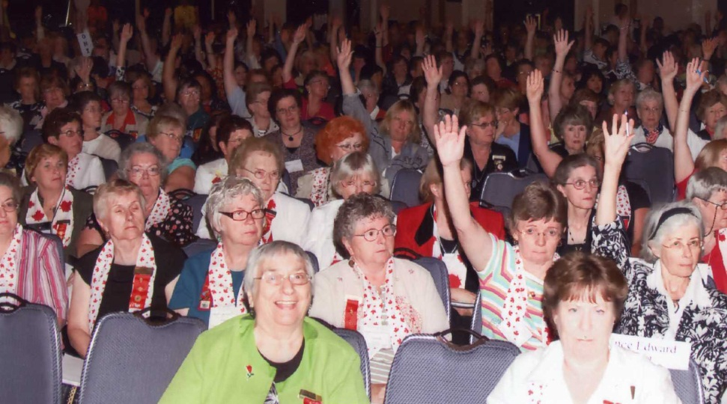
DKG offers members
Conferences
Affinity benefits
Professional
Liability Insurance
Notes:
The international Web site (www.dkg.org) is a source for detailed information about benefits offered to members. The international organization also offers a private social network for members that offers interest groups such as librarians and art teachers. The Society also provides a news source The DKG NEWS and a juried, professional journal ,The Bulletin.
Presenters should describe chapter and/or state organization Web site information and additional communication sources.

Slide 11
Plus…
Networking opportunities
Private social network
Face-to-face learning opportunities
Support as you strive for your own excellence
Notes:
Through the honor of knowing and working with key women educators in your community, state, and around the world you will have extensive networking opportunities and support.
Presenters may wish to take this opportunity to describe chapter and/or state organization personal development or other learning opportunities.
Presenters may also want to share any personal stories of networking and DKG friendships across geographical lines.

Slide 12
Seven purposes and many ways of putting them into action
To unite women educators of the world
2. To honor women
3. To advance the professional interest and position of women in education
Notes:
Our first Purpose – To unite women educators of the world in a genuine spiritual fellowship – is one that many members feel is unique to our organization. (There are many examples of “genuine spiritual fellowship” and presenters may want to provide their own.) Nearly everyone who has worked outside her chapter can tell a story about meeting a member from another city, state organization or country and immediately feeling a kinship that is difficult to describe which in many cases turns into a life-long friendship.
To honor women who have given or who evidence a potential for distinctive service in any field of education. We consider active membership the most visible way we can honor outstanding women educators. Chapters, state organizations and the international organization also find ways to honor members and non-members who exhibit excellence. We give achievement and service awards and other recognitions so that what the community seldom does – recognize extraordinary educators in a positive way – the Society does regularly with the goal of raising external and internal pride in the profession.
To advance the professional interest and position of women in education. Our Founders were dismayed by opposition to efforts by women to gain equal pay and opportunities for administrative positions. Ever since the founding, members have been supported as they seek advanced education and push for equal rights and professional benefits, including opportunities for supervisory and administrative positions. Today, through networking, assistance with advanced degrees, certification and professional development, we continue to help member be the best the can be and open doors for other women educators around the globe.

Slide 13
Seven purposes and many ways of putting them into action:
To support desirable legislation
To endow scholarships to women pursuing graduate degrees
6. To stimulate personal and professional growth
of members
7. To inform members of current
educational issues
Notes:
4. To initiate, endorse and support desirable legislation or other suitable endeavors in the interests of education and women educators. While the Society does not support political candidates or parties, the US, Canadian, Latin American and European Forums highlight and support educational policy and community efforts. The US Forum supports a National Legislative Seminar in Washington, DC , and Canadian and Latin American Forums support projects that bring community leaders together to discuss educational issues. The European Forum presents academic papers, panel discussions and other presentations which educate members about common issues.
5. To endow scholarships to aid outstanding women educators in pursuing graduate study and to grant fellowships to non-member women educators. In the 2009 fiscal year the Society gave over $3,000,000 in grants and scholarships; clearly, we are a major player in the philanthropic world. Our World Fellowship program awards grants to women educators from around the world to pursue advanced degrees in the United States and Canada.
6. To stimulate the personal and professional growth of women educators and to encourage their participation in appropriate programs of action. The Society offers members outstanding leadership training and encourages members to step out of their comfort zones to accept leadership opportunities. The International Society offers a two-week leadership Management Seminar at a graduate business school at a large university. Many state organizations offer leadership training opportunities. (Presenters should describe any opportunities available.)
7. To inform the members of current economic, social political and educational issues so that they may participate effectively in a world society. Chapters offer programs of quality that inform and/or lead to action by members. After studying the environmental issues confronting the Everglades, a Florida chapter took an overnight trek of the Everglades to see the damage personally. After hearing about the plight of siblings of sick children in Namibia, a Texas chapter made “Clean Kids Packets” for families visiting a hospital in Windhoek. This type of education and resulting action is repeated in all 77 state organizations of the Society. (Presenters should describe an outstanding local program.)

Slide 14
Members contribute to the Society by…
Participating
Sharing
Seeking out opportunities
Paying dues and fees
Becoming involved
Accepting leadership roles
Notes:
Participating in meetings, projects, and activities of their chapter, area, state organization and international
Sharing interests, talents and professional expertise – we want to learn from you
Seeking out opportunities to grow personally and professionally and supporting others in their growth – we encourage each other
Paying dues and fees in a timely manner
Becoming involved in chapter life by attending meetings and
other activities, by using voice and vote in chapter business, by
taking risks and taking advantage
Accepting leadership roles in the safe, supportive environment of the Society
Presenters should describe the dues structure for the chapter and also describe how new members become involved in chapter life. Chapter meeting times and place should be described.

Slide 15
The Delta Kappa Gamma Society International was founded
To bring together qualified women educators serving in a broad spectrum of educational fields and
To strengthen qualified women educators serving in a broad spectrum of educational fields and
To pursue worthwhile projects.
Notes:
The Society has a rich history of support for women educators. We tackle professional projects that make a difference in our communities and across the world.
The international Society currently supports the Schools for Africa project – transforming lives through education (www.unicefusa.org).
Schools for Africa is a joint project of UNICEF, The Nelson Mandela Foundation, The Hamburg Society and the Delta Kappa Gamma Society. The project helps girls, orphans and children living in extreme poverty; it is currently serving children in Angola, Burkina Faso, Ethiopia, Madagascar, Malawi, Mali, Mozambique, Niger, Rwanda, South Africa, and Zimbabwe. The project builds or rehabs schools; trains teachers; supplies notebooks, pens, desks, chairs, and other materials; assures that schools have safe drinking water and separate bathrooms for boys and girls; and creates schools that offer a protective environment.
The Society has been a longstanding UNICEF partner; recently ending a joint successful project in Afghanistan that assisted in teacher training and re-training.
The Society maintains a presence at the United Nations as a non-governmental organization with Economic-Social Committee Consultative Status.

Slide 16
The Delta Kappa Gamma Society International
The organization continues to impact excellence in education worldwide in a variety of ways
but most directly as it focuses on supporting early-career educators.
Notes:
Many chapters within the Society have had programs over the years to support and mentor new teachers. But as the drop-out number of early career educators continues to rise in most of our member countries, including the United States, there is a growing dedication to be a part of the solution in this crisis. The Society’s International Educational Excellence Committee is spear-heading promotion of activities in this area. Suggestions for chapter involvement are posted on the Web site, in publications and in training opportunities.
Presenters can use this opportunity to describe any local activities in this area.

Slide 17
The Honor of Membership
Someone noticed your work.
Someone noted your standards.
Someone believed in your potential.
Someone sought your association.
Someone sponsored your invitation.
Someone honored you.
Remember that person’s confidence in you.
Consider your membership invitation carefully.
Notes:
This is the only slide that we suggest the presenters read to the group.
Invitees should be thanked and asked for questions. If there are any questions that cannot be answered about international activities or projects email mem@dkg.org and communicate to the invitee the answer.
Presenters should give invitees the timeline for the next steps that they can take to accept membership or decline membership at this time.

Slide 18
Pride in the Big Picture
The Delta Kappa Gamma Society International
The Orientation Guide is a presentation of the 2010-2012 International Membership Committee
with special thanks to Corlea Plowman, Linda Eller and Camille Kuntz
Notes:
End of Presentation

